Slide 1
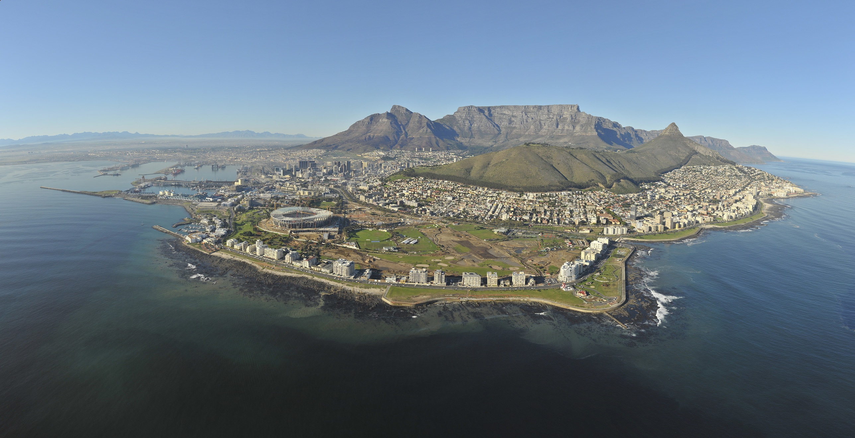
Professor Sue Parnell, University of Cape Town
WORLD UNIVERSITIES NETWORK
GLOBALISING ACADEMICS: URBAN
BRISTOL, FEB 2012

Slide 2
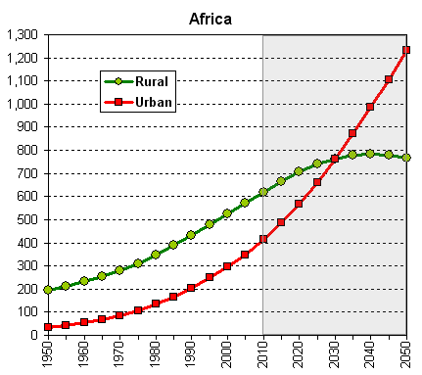
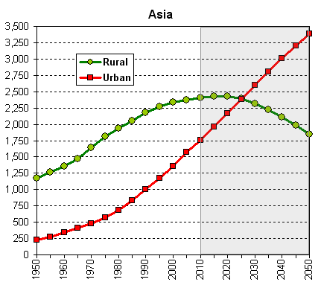
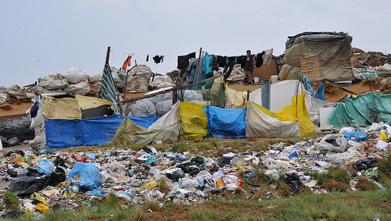
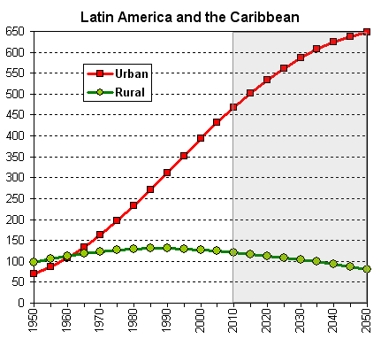
Source: United Nations, Department of Economic and Social Affairs, Population Division: World Urbanization Prospects, the 2009 Revision. New York, 2010

Slide 3
We face a Southern urban future
The demographic transition of the late twentieth and early twenty first century has shifted the locus of the urban population from the Global North to the Global South.
As the theoretical epicentre of urban scholars and policy makers adjusts to accommodate this transition, some reallignment in how ideas are weighted and applied is inevitable.
This recalibration, while not necessary comfortable to those in established positions of intellectual power, is desirable and may even be overdue.
THE ENTIRE ENTERPRISE OF URBAN RESEARCH NEEDS GLOBAL RECONFIGURATION

Slide 4
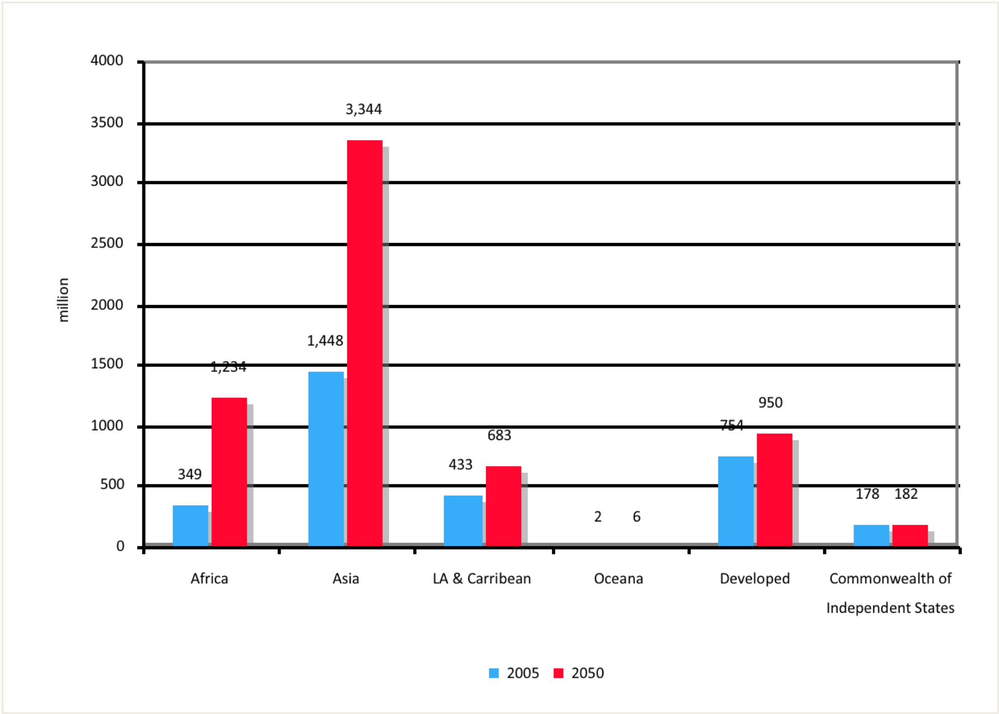
There is a mismatch between where cities are and which cities scholars write about …creating an imperative for entrepreneurial global research – but is this an opportunity or threat?
High impact research needs big funding and a large research community
The urban crisis, like agriculture or HIV, is likely to be well funded and attract ‘big science research’
High impact research tends to be multi disciplinary and multi-site

Slide 5
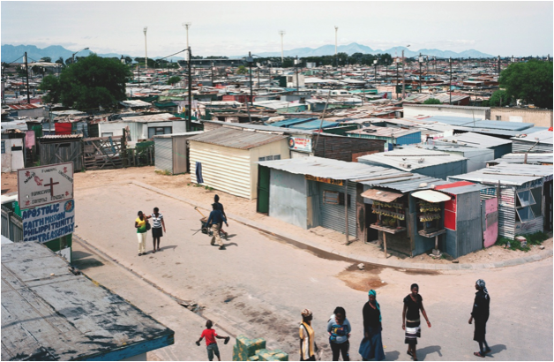
Global Urban Research - Parnell
Urban Health – and complexity science (ICSU)
Urban Governance and Poverty; Alcohol and urban poverty (ESRC/DFID)
Spatial Justice (CNRS/AFD)
Urban Food Security (IDRC)
Urban Futures (MISTRA)
African Centre for Cities
http://www.acc.uct.ac.za

Slide 6
Urban Health and Complexity Science (ICSU)
Transdisciplinary Objective
Lessons
A call for new knowledge - based on the observation of a poorly understood real world problem
Articulate core issues and shared methods
Identify new funding streams
Paradigmatic differences about knowledge production exist. Disciplinary outliers (anthropology and cardiology) found it hard to speak across methods and recognise each others data as legitimate
Unusual opportunity to explore transdisciplinary research domain without undertaking primary research.
The institutional structure of ICSU, ie geographical representivity, does fit the transdisciplinary purpose

Slide 7
Urban Governance and Poverty (ESRC/DFID) 5 years total budget 5 million pounds, local budget 15 000 pounds
Lessons
Objectives
Donor driven agenda to understand urban poverty
Wide brief with no core questions
Diffuse intellectual leadership
Multi- dimension research emerged out of international scale of project and imperative of finding local partners
If a project is long enough and has a big enough budget something good can emerge
Effective multi-disciplinary work comes from trusting relationships – bottom up learning.

Slide 8
Urban Food Security (IDRC) 4 million $Can – 4 years
Objectives
Lessons
Take an established interdisciplinary area into new geographic domain (nutrition, public health, economics, anthropology, geography, planning)
Create curricula
Train professionals
Impact policy
Funded teaching cannot lead a program if there is no high level research capacity and a body of work to teach from.
Imposing new multi/ transdicplipinary courses cuts out core modules.
New areas of research are not sustainable without committed leadership and institutional support

Slide 9
Urban Futures (MISTRA) 2.2million euro a year for 10 years, local funding 1.5 million rand + 10 years
Objectives
Observations
Change the path of the urban future by generating new knowledge
The co production of knowledge by academic and non academic partners
TD research across the urban disciplines
Link theory and implementation
Long term program increases opportunities for success
Combination of top down and bottom up TD innovation
Extremely demanding leadership and institutional support required
Project scale can distort other research capacity

Slide 10
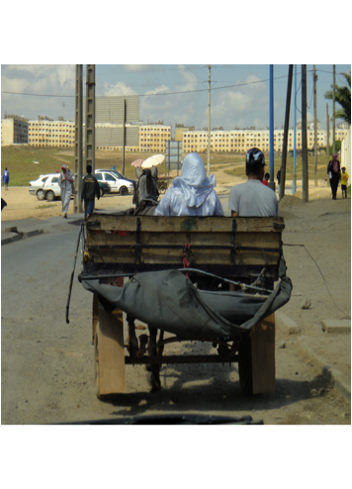
Understanding cities of the Global South implies:
Trans/inter/intra disciplinary research
Comparative research
Applied research
Mixed methods research
Multi author research
Research that engages human subjects and/or is field based, necessitating ethical clearance
Large budgets and good admin support

Slide 11
BUT …globalising the urban research agenda is not simple
Funding – fiscal crisis in the North means cuts for expensive international research
High levels of knowledge and skill are needed to engage new urban contexts, especially because secondary literature is thin.
Primary research takes time, is costly and sometimes unsafe.
Who takes ethical responsibility?
Who is the PI?
Authorship vs. fieldworker status?
Brain drain

Slide 12
Urban research domains need extra- disciplinary institutional support
A process of peer review and assessment, including appropriate journals
An organizational system for student training
An institutional structure for career advancement
Stable research funding
A professional body or alternative mechanisms for distribution information and inserting knowledge into practice
THIS IS HARD IN A WELL RESOURCED WELL ESTABLISHED UNIVERSITY – WHAT DOES IT MEAN FOR AFRICAN INSTITUTIONS?

Slide 13
http://africancentreforcities.net/

