Slide 1
Analysing educational trials: the Education Endowment Foundation Archive
Steve Higgins, Adetayo Kasim, ZhiMin Xiao, with Nasima Akhter, Ewoud De Troyer, Quentin Dhumeaux, Mengchu Li
s.e.higgins@durham.ac.uk
@profstig
'Bristol Conversations in Education' seminar series, School of Education, Bristol University
24th October, 2018

Slide 2
The EEF Archive aims:
1. To track the impact of EEF projects longitudinally (by linking to the National Pupil Database)
2. To compare and group the effects of different projects so to draw lessons about which approaches to teaching and learning are most effective generally, and which are effective for different groups (such as FSM)
3. To answer methodological questions about research design, analysis and outcome measurement in educational trials
4. To investigate the cumulative impact of projects on schools and pupils; and
5. To understand better EEF’s target group of disadvantaged pupils.

Slide 3
The Archiving Process
Independent evaluator submits data from EEF project to FFT
FFT re-match with National Pupil Database (NPD)
Batch transfers to Durham every six months
New NPD data added when available (annually)
65 projects to date (out of 135 commissioned)
About 750,000 pupils
EEF Archive small grants – DfE/ONS

Slide 4
Principles and caveats
Principles
Independent evaluator’s peer-reviewed published estimate is always the official EEF finding for impact on attainment
Exploratory analysis to inform EEF’s evaluation strategy
Help to explain variation in trial impact
Agreed process should errors be identified
Caveats
Can’t always match N (4/39 projects greater than 10% difference)*
NPD data removed and re-matched
Additional covariates may alter the N and alter the effect size
Some raw scores transformed
Gain score distribution may differ from post-test
* ‘included in final analysis’ tag now required on deposit with FFT

Slide 5
Durham process and progress
Initial exploration
Development of analytic models
Different effect size calculation (Cohen’s d, Hedges’ g, Glass’ Δ),
Post-test only comparisons (δ)
Gain score
Ordinary least squares (OLS)
Multi-level models
Explore variances within, between, total
Frequentist
Bayesian
Design specific: individual randomisation, cluster, multi-site
R package ‘EEFanalytics’ https://CRAN.R-project.org/package=eefAnalytics
Initial exploration
Development of analytic models
Different effect size calculation (Cohen’s d, Hedges’ g, Glass’ Δ),
Post-test only comparisons (δ)
Gain score
Ordinary least squares (OLS)
Multi-level models
Explore variances within, between, total
Frequentist
Bayesian
Design specific: individual randomisation, cluster, multi-site
Control for:
Baseline
School/ clustering
Design
Xiao Z., Kasim, A., Higgins, S.E. (2016) Same Difference? Understanding Variation in the Estimation of Effect Sizes from Educational Trials International Journal of Educational Research 77: 1-14 http://dx.doi.org/10.1016/j.ijer.2016.02.001

Slide 6
Initial findings
17 EEF projects
Four analytic models
Findings
Results converge in larger, unproblematic trials
Point estimates and estimates of precision vary when trials are problematic (e.g. testing issues, randomisation), when design and analysis not matched; with different co-variates added; when outcomes are different or transformed (e.g. z-scores)
Results tend to diverge if ICC ≥ 0.2 and there are few clusters/schools
MLM total variance ‘most conservative’ model (wider Confidence Intervals)
Bayesian estimates identical but more precise (narrower Credible Intervals)

Slide 7
Variation
56 outcomes from 39 projects
32 outcomes small difference ≤ 0.05
19 between 0.06 and 0.10
2 between 0.11 and 0.19
2 large difference > 0.20 (Discover Summer School, Mind the Gap)
Mean difference is zero

Slide 8
Variation in estimates
Stem | Leaf
-0.2 -0.1 -0.0 0.0 | 5 0 1 1 1 1 2 3 4 4 4 4 4 4 4 5 5 5 5 6 6 6 7 7 7 7 7 8 9 9 0 0 0 0 1 1 1 1 2 3 4 4 4 5 5 5 6 7 7 8 8 8
0.1 | 1 5 7 7 8
0.2 | 4
Stem | Leaf
-0.2 -0.1 -0.0 0.0 | 5 0 1 1 1 1 2 3 4 4 4 4 4 4 4 5 5 5 5 6 6 6 7 7 7 7 7 8 9 9 0 0 0 0 1 1 1 1 2 3 4 4 4 5 5 5 6 7 7 8 8 8
0.1 | 1 5 7 7 8
0.2 | 4
Stem and leaf plot of differences between Evaluator and archive MLM total variance estimates for 56 primary outcomes across 39 projects

Slide 9
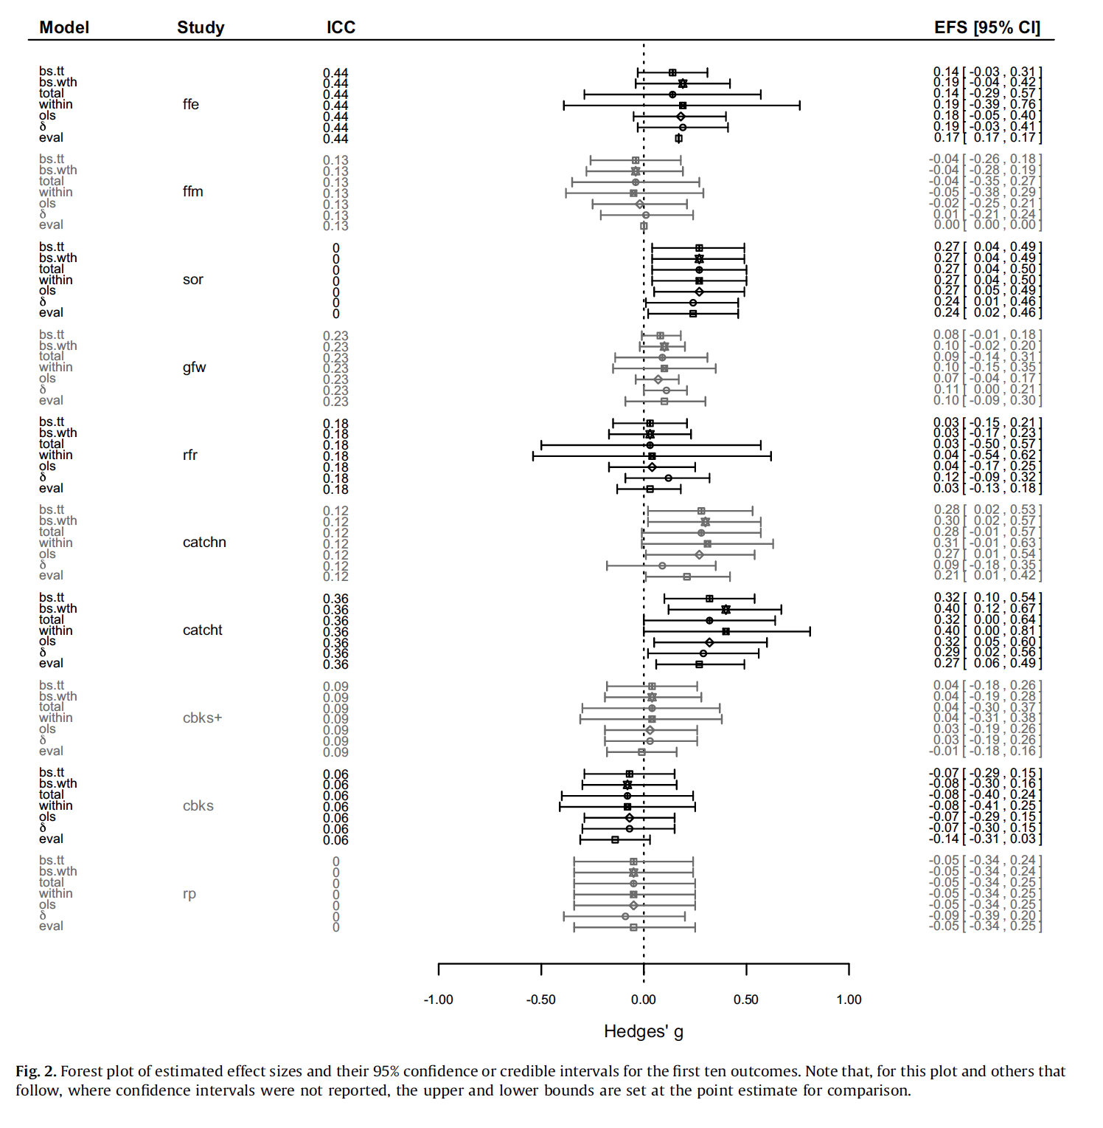
Overview of variation

Slide 10
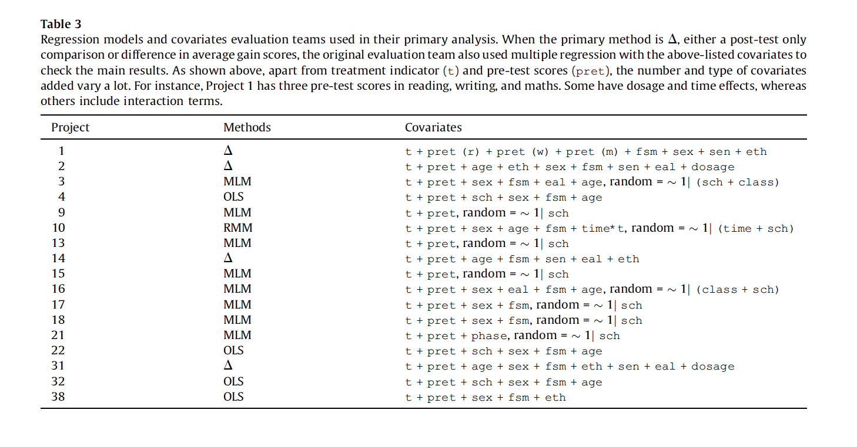
Sample of evaluator models
Xiao Z., Kasim, A., Higgins, S.E. (2016) Same Difference? Understanding Variation in the Estimation of Effect Sizes from Educational Trials International Journal of Educational Research 77: 1-14 http://dx.doi.org/10.1016/j.ijer.2016.02.001

Slide 11
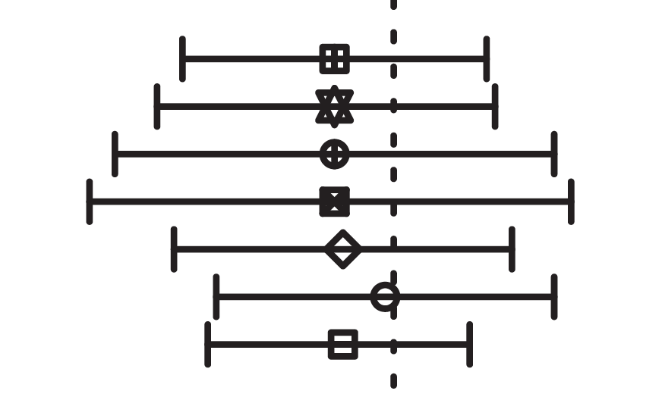
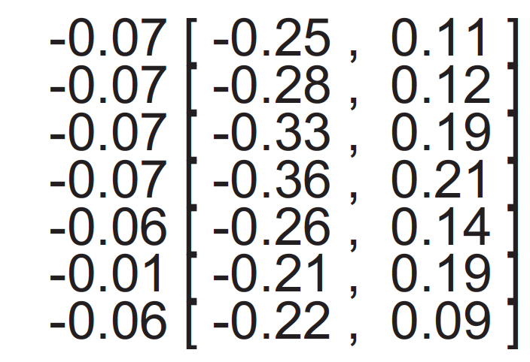
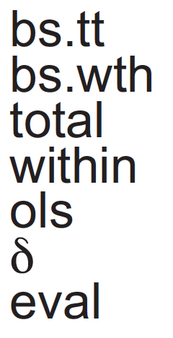
Convergence: Text Now
0
Pre-test imbalance

Slide 12
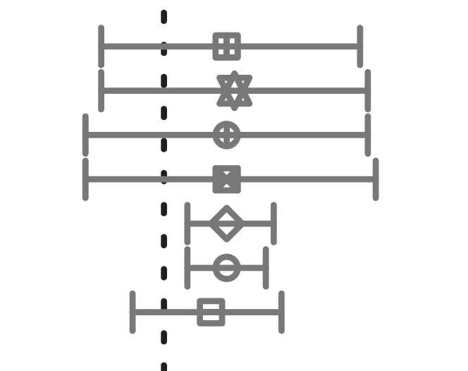
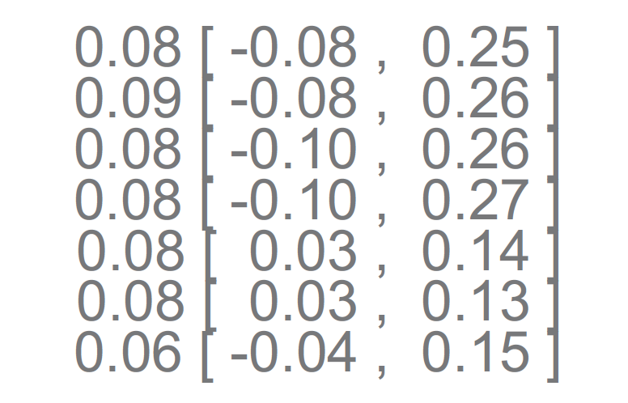
Clustering: Maths Mastery Secondary
0
Point estimates similar, CIs vary

Slide 13
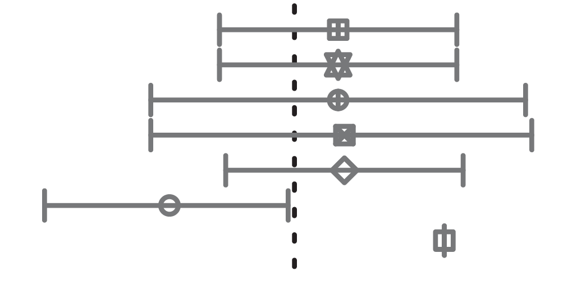
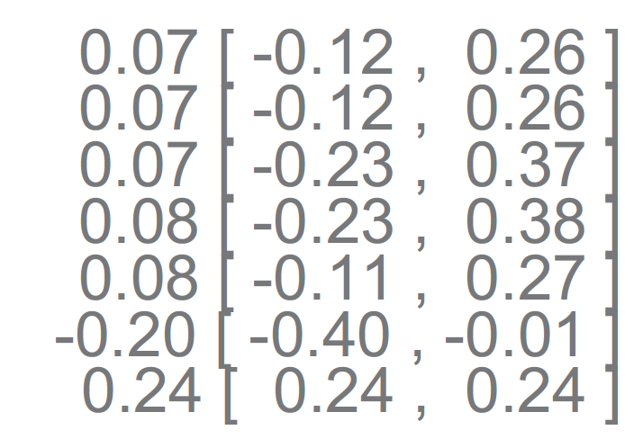
Divergence: Fresh Start
0
Large pre-test imbalance
Post-ANCOVA models correct for this
Evaluator gain estimate much higher
Post/gain differences

Slide 14
Other explorations
What extent of imbalance at baseline can be adequately addressed with a post-test analysis (Lord’s Paradox)?
Treating multisite trials as cluster randomised trials and using Hedges’ (2007) formula can be overly conservative
Exploring individualized treatment effects/ updating binomial effect size display (Rosenthal & Rubin 1982)
How best to deal with missing data - different imputation methods produce different effect size estimates and can also introduce bias
Subgroup or interaction analysis – when is each better?

Slide 15
Thorny issues and reflections
Thorny issues
p-values and uncertainty estimates
Messages – project level & archive level consistency?
Means or distributions? (cf. Deaton & Cartwright (2016) on RCTs & Average Treatment Effects)
Replication and direct comparisons?
Reflections
What is acceptable analytic variation?
What is the best estimate of the ‘average treatment effect’?
How much should evaluators be constrained for comparability?
With intention to treat approach, sample sizes predicated on minimum necessary to detect a probably overestimated EEF Toolkit effect size, and using MLM total variance are we being too conservative?

Slide 16
Publications
Kasim, A., Xiao Z., Higgins, S.E & De Troyer, E. (2014) eefAnalytics [Computer software] https://CRAN.R-project.org/package=eefAnalytics
Higgins, S. (2016) Meta-synthesis and comparative meta-analysis of education research findings: some risks and benefits Review of Education 4.1: 31–53. http://dx.doi.org/10.1002/rev3.3067
Higgins, S. & Katsipataki, M. (2016) Communicating comparative findings from meta-analysis in educational research: some examples and suggestions International Journal of Research & Method in Education 39.3 pp 237-254 http://dx.doi.org/10.1080/1743727X.2016.1166486
Xiao Z., Kasim, A., Higgins, S.E. (2016) Same Difference? Understanding Variation in the Estimation of Effect Sizes from Educational Trials International Journal of Educational Research 77: 1-14 http://dx.doi.org/10.1016/j.ijer.2016.02.001
Xiao, Z. Higgins, S. & Kasim, A (2017) An Empirical Unravelling of Lord's Paradox The Journal of Experimental Education http://dx.doi.org/10.1080/00220973.2017.1380591
Xiao, Z., & Higgins, S. (2018). The power of noise and the art of prediction. International Journal of Educational Research, 87, 36-46. http://dx.doi.org/10.1016/j.ijer.2017.10.006
Higgins, S. (2018) Improving Learning: Meta-analysis of Intervention Research in Education Cambridge: Cambridge University Press http://dx.doi.10.1017.9781139519618

