Slide 1
Globalising Research - an Industry View
Dr Peter Gist
Director: Project Creation, Arup

Slide 2
Contents
Arup
Our challenges
How do we do our research?
Relationships with Universities
Challenges for you!

Slide 3
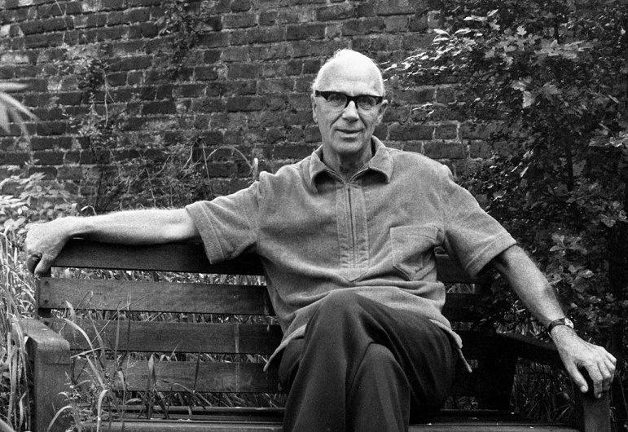
Arup – a profile
A trust, not a public company
9500 employees worldwide
85 offices
Multidisciplinary services focused on the built
environment– initially across engineering,
now includes social, economic and environmental disciplines
We want to benefit society and deliver the best quality of work - investing to develop knowledge and capability
Major projects include:
Sydney Opera house (Australia)
Channel Tunnel Rail Link (UK)
Beijing Olympics – Water cube and Bird’s Nest stadium
Design and innovation are business differentiators

Slide 4
Our challenges
The challenges which drive our business are global
Mitigating and adapting to climate change
Demographic change
Successful solutions are multi-disciplinary
Research must have a business case

Slide 5
How do we do our research?
Research strategy
Consultation with business units and clients: roadmaps (key drivers > opportunities for Arup > research themes)
Research execution
In-house
Collaboration with universities, research councils, clients and others
Validation and deployment
Refereed publications and “thought leadership” papers
Improvement to existing services and development of new services
Commercialisation of IP (products) and “ project creation”
Capability development
Arup University sponsored PhDs e.g. EngDs with University College London
Bespoke Masters modules (e.g. with Cambridge, Imperial College)

Slide 6
Roadmaps for research strategy e.g. water

Slide 7
Arup approach to research funding
In –house and external collaborative research
Regional allocation – UK, EU, USA, East Asia, Australasia
Global allocation – to bridge national boundaries
Simple and fast ‘Investment in Arup’ research proposal tool
Turn-around time <1 week
Open ‘responsive mode’ plus directed calls – 80:20 ratio, Research Roadmap-focussed
May fund associated studentships, e.g. CASE, EngD

Slide 8
Arup’s Global Research Challenge 2011
Our first global call for research proposals – open to Arup, academic partners, clients and other industry collaborators
Assessment of critical infrastructure
Can we increase resilience, reduce environmental impact, improve financial performance?
The impact of the built environment on well being and performance
Can we measure the effects to enable better design?
Innovative delivery structures for “retrofitting” cities
What approaches to funding, procurement, construction and operation will improve energy efficiency and reduce carbon emissions?

Slide 9
EU collaboration: Energy Efficient Buildings PPP
Arup is UK representative
Shape
EU-wide Public-Private-Partnership
Large scale research (80%) and demonstration (20%) program
Driven by the industry grouped in E2B Association
Size
Aspiration: €2 billion over 10 years
Commitment: €500m from 2010-2013 from president Barroso
Remit
Reduce energy consumption and CO2 emissions
Improve EU energy independence

Slide 10
“SoundLab” for transport projects

Slide 11
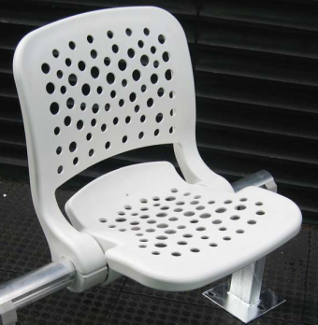
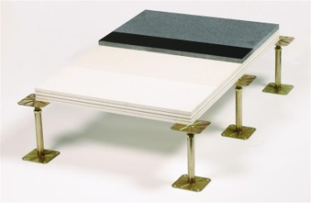
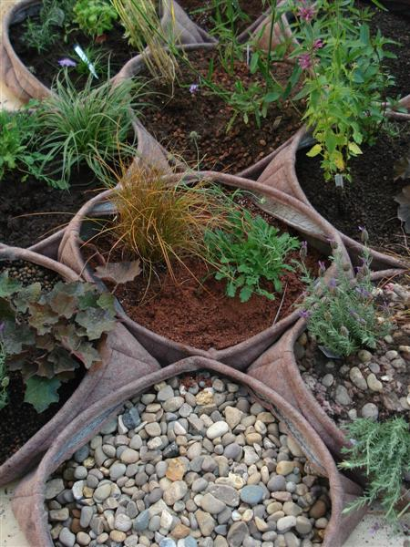
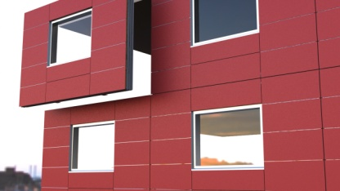
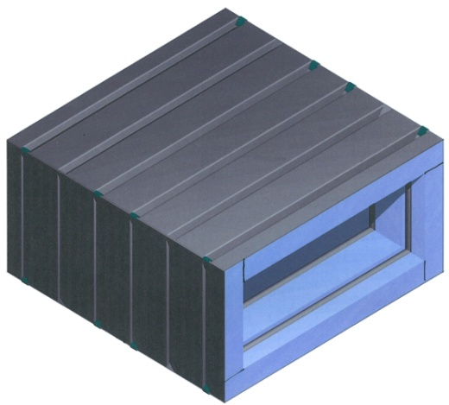
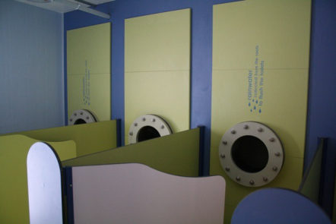
Taking ideas to commercialisation
Abacus, Stadium Seat
Technik Floor
Pocket Habitat
Technik Wall
OvaVent
FlowStow, rainwater attenuation.
http://networks.intranet.arup.com/products/home.cfm
free radicals
innovation jam
18-20 October 2011

Slide 12
Relationships with Universities
Relationships with universities are multi-layered - we are developing MOUs to bring together them together
 | Research | Consultancy | Education
Competitor | √ | √ | ?
Collaborator | √ | √ | √
Supplier | √ | √ | √
Client | X | √ | √

Slide 13
Challenges for you!
Firms like Arup need University collaborators for research
Are Universities good collaborators for applied research?
“Traditional” rewards for academics – individual advancement through peer reviewed research. “Contribution to the subject” not relevance to application and performance in application .
Many funders and universities embracing change – multi-disciplinary applied research, involving industry and global collaboration. Rewards for enhancing the reputation (and funding) of the department , research centre and university – a more “corporate approach”.
Our experience of collaboration internationally is very mixed!
Do universities want to/need to change? Are incentives aligned? Are processes for delivery aligned?

